Slide 1
Yibin

Slide 2
Located in southern Sichuan, at the confluence of the Jinsha River, Min River, and Yangtze River, earning the title "The First City of the Yangtze River". Known as "China’s Liquor Capital" (home of Wuliangye) and "Bamboo City" (famed for the Shunan Bamboo Sea). Rich historical and cultural heritage, including ancient towns and revolutionary sites like the Zhao Yiman Memorial Hal.
Yibin
位于四川省南部，金沙江、岷江、长江交汇处，素有“长江第一城”的美誉。被誉为“中国酒都”（五粮液之乡）和“竹城”（以蜀南竹海而闻名）。历史文化遗产丰富，包括古镇和革命遗址赵义满纪念馆等。

Slide 3
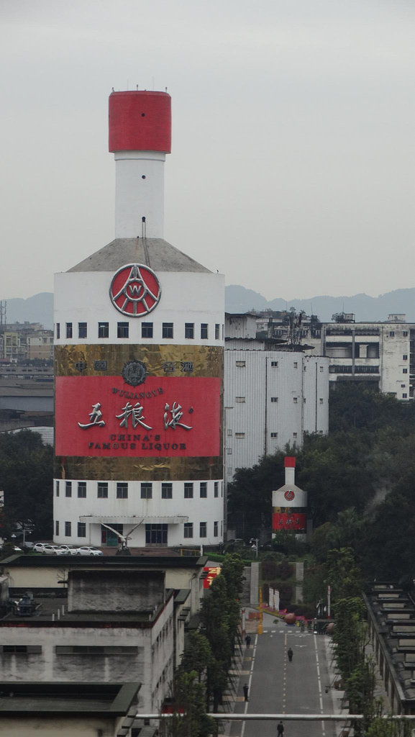
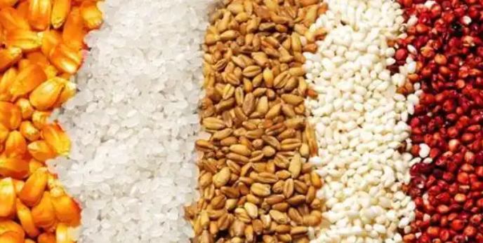
Wuliangye – China’s Liquor King
One of China’s most iconic liquors, produced in Yibin since the Ming Dynasty.
Uses five grains (sorghum, rice, glutinous rice, wheat, corn) and ancient fermentation techniques.

Slide 4
Yibin Burning Noodles
What is it?

Slide 5
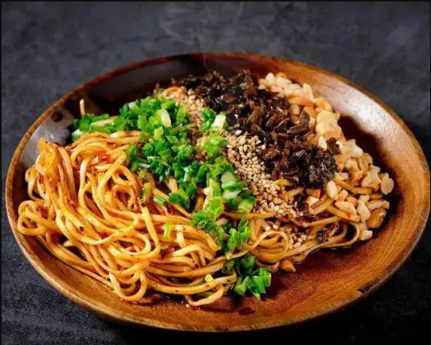
Yibin Burning Noodles
A traditional Sichuan snack originating in Yibin, originally called Xufu Burning Noodles.
Named for its oil-rich, water-free texture that allows it to ignite when lit.
Key Ingredients:
Local noodles, Yibin preserved vegetables (Sui Mi Ya Cai), chili oil, sesame, peanuts, and spices.
Features:
Spicy, aromatic, and crispy. Served with a light broth to balance richness.
起源于宜宾的四川传统小吃，原名徐府烧面。以其富含石油、无水的质地命名，使其在点燃时能够点燃。主要成分：当地面条、宜宾腊菜（隋米雅菜）、辣椒油、芝麻、花生和香料。特征：辣、香、脆。配以清淡的肉汤，以平衡油腻感。

Slide 6
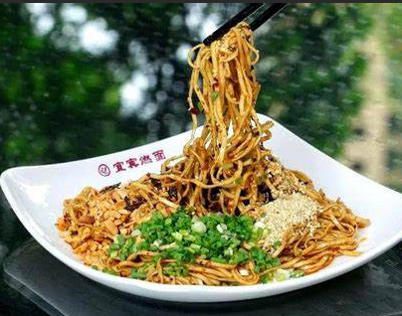
Yibin Burning Noodles
History:
Dates back to the Qing Dynasty (late 19th century).
Awards:
Recognized as a "Chinese Famous Snack" (1997) and listed in Sichuan’s Intangible Cultural Heritage (2011).
Modern Variations:
Includes meat-based (Hun Ran Mian) and soup versions (Ran Tang Mian).
历史：可以追溯到清朝（19世纪末）。奖品：1997年被认定为“中国名小吃”，2011年被列入四川省非物质文化遗产名录。现代变奏曲：包括肉制品（浑然面）和汤制品（然汤面）。

Slide 7
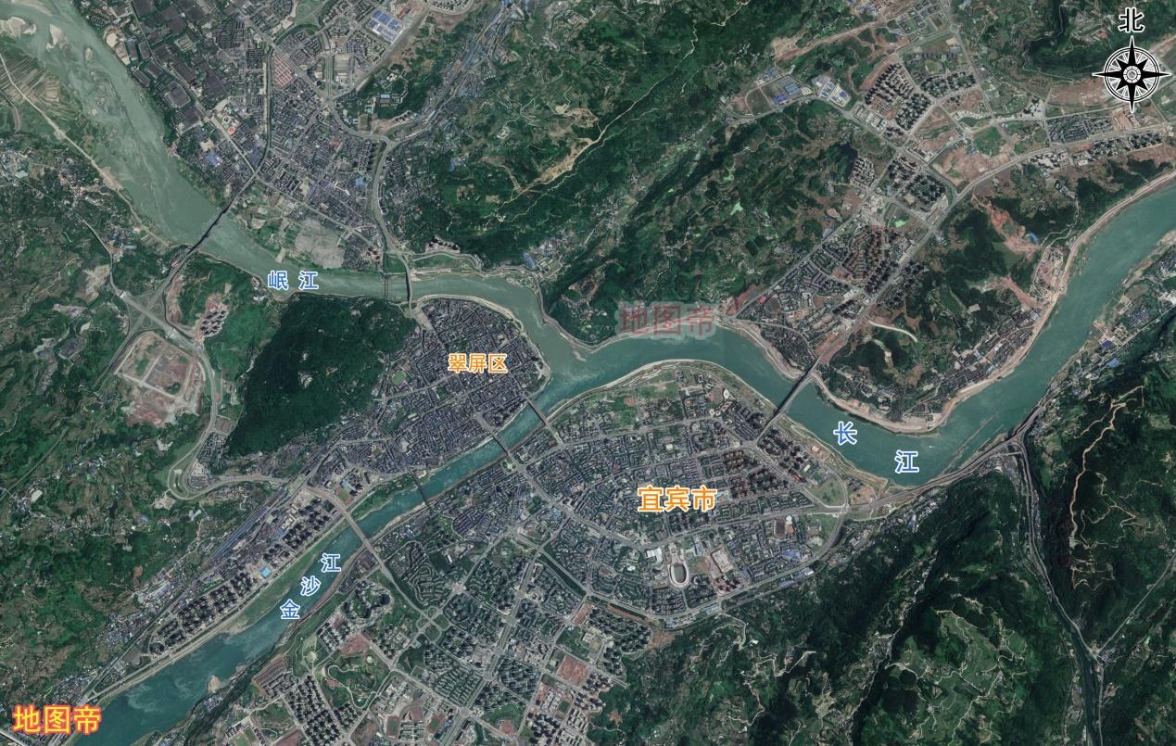
The First City of the Yangtze River
The Yangtze River officially begins at Yibin’s Three Rivers Convergence (Jinsha + Min = Yangtze).
Symbolic Role:
A hub for trade, culture, and ecology along the Yangtze Economic Belt.
Why "First City"?
长江正式发源于宜宾三江交汇处（金沙+岷江=长江）。象征性角色：长江经济带沿线的贸易、文化和生态中心。

Slide 8
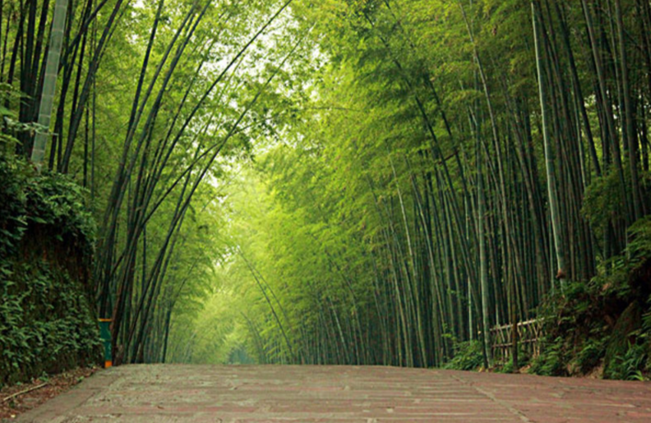
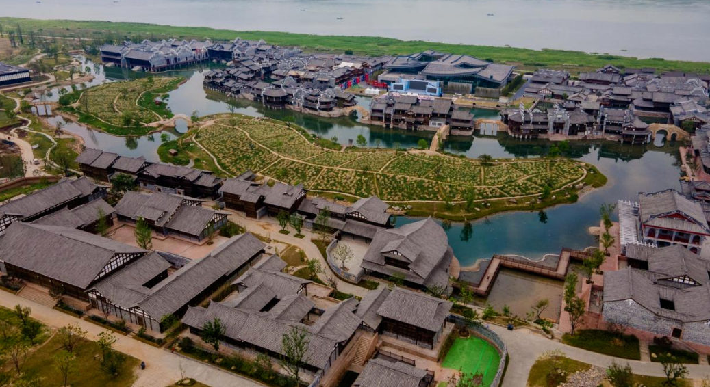
Key Attractions
Shunan Bamboo Sea:
World’s largest natural bamboo forest (70,000+ acres), offering bamboo-themed art, cuisine, and eco-tourism.
Lizhuang Ancient Town:
A WWII cultural center with Ming-Qing architecture and historical museums.
WWII:world war II
世界上最大的天然竹林（70000多英亩），提供以竹子为主题的艺术、美食和生态旅游。
二战文化中心，拥有明清建筑和历史博物馆。

Slide 9
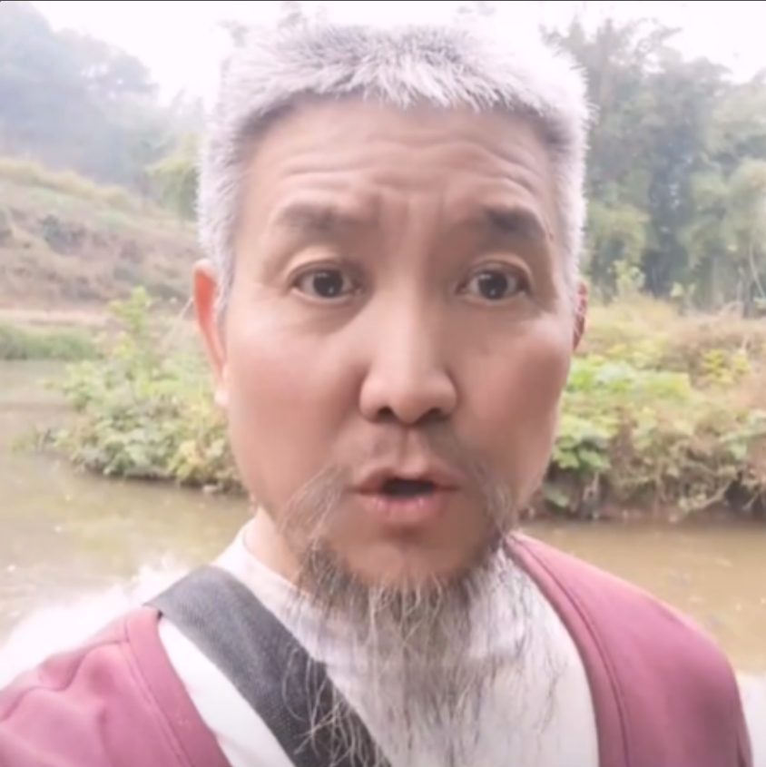

The last real dragon in Sichuan
Chuan Long Er Hu

